Slide 1

Battle of the Neighborhoods Next Charlotte Neighborhood COVID 19 Testing Center
Kimberly Cox-Fisher

Slide 2
Items to Discuss:
Need for Testing Accessibility for communities of Charlotte
Opportunity
Data Used in Analysis
Methodology
Observations and Results
Recommendation and Conclusion

Slide 3
Need for Testing Accessibility for Communities of Charlotte
COVID-19 has had negative impact on communities of Charlotte
Fall and Winter has brought on influx of new COVID-19 cases
No end in sight until vaccine is accessible to everyone in the community
Shortage of testing has improved over course of pandemic for the Charlotte communities
People still experience difficulty in accessibility

Slide 4
Opportunity
Serve the neediest of Charlotte by providing accessibility to COVID-19 testing…while providing important insights to the city of Charlotte about infection spread

Slide 5
Data Used in Analysis
Four sources of data used for this project:
North Carolina Department of Health and Human Services -->COVID-19 Data--> About the Data-->Zip Code Cases and Death Table https://covid19.ncdhhs.gov/dashboard/about-data
North Carolina Department of Health and Human Services COVID-19 --> Test Site Finder https://covid19.ncdhhs.gov/about-covid-19/testing/find-my-testing-place/test-site-finder
FourSquare Locator API Data
Public OpenDataSoft https://public.opendatasoft.com/explore/dataset/us-zip-code-latitude-and-longitude/table/?rows=77

Slide 6
Methodology
Observation of data points in plotting the Cases and Deaths by Zip Code table into a map of Charlotte.
Observations included parts of city impacted by COVID-19
Overlayed testing centers across Charlotte into map
Observations of where testing centers were in relation to neighborhoods in the city
Added venue data from FourSquare
Inferred population residing in gathering based on availability and accessibility of venues
Segmented and clustered venue data to observe the above

Slide 7
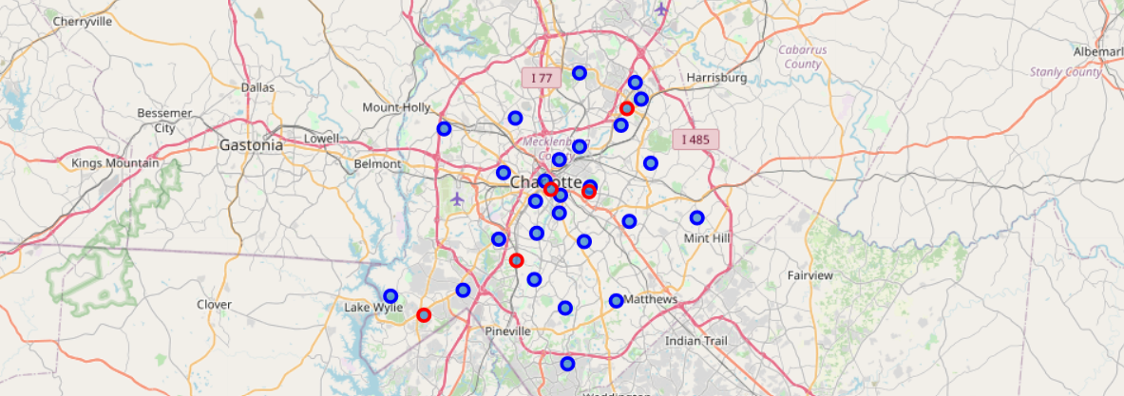
Observations and Results
Map of Charlotte and positive test cases and deaths
Red: Testing center locations
Blue: Location of positive test results by zip code

Slide 8
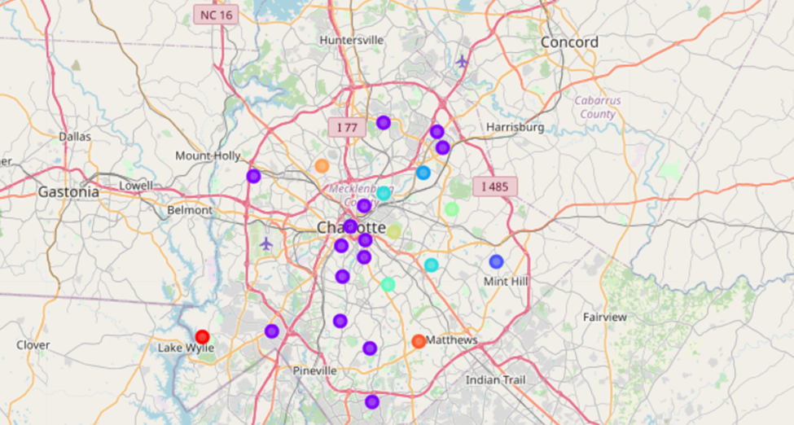
Observations and Results
Segmenting and Clustering Mapping of Venues across City

Slide 9
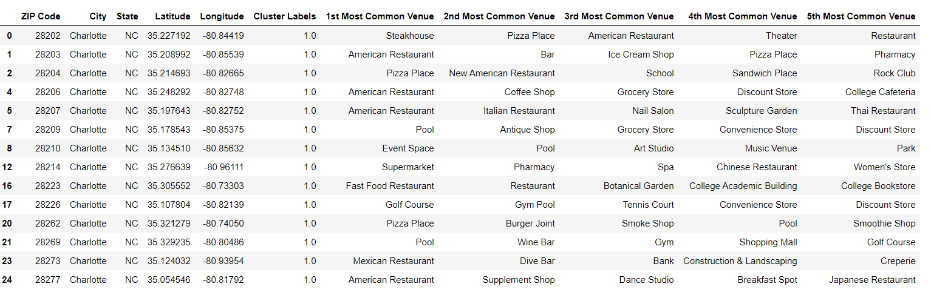
Observation and Results
Southwest Charlotte-Red Cluster
The lack of restaurants and venues suggest that this is not an area where there are many people gathering. It is also not a very affluent part of the city, but more of a lower middle class area.
South Charlotte/University City-Purple Cluster
This area has a high number of restaurants and coffee shops. This cluster also contains very affluent neighborhoods in Charlotte.

Slide 10
Observations and Results
Mint Hill-Blue Cluster
This area does not offer many venues that would suggest a high level of gathering or possibly residing in. This area has some affluence, but it has mainly lower- to middle-class people that reside here.
North Charlotte-Light Blue Cluster
This neighborhood also does not offer many venues that suggest a high level of gathering. This area is known to have a higher level of unemployment than other areas of the city, while still considered middle class.
East Charlotte/North Charlotte-Light Green
This neighborhood also does not suggest a high level of gathering. It also has a higher level of unemployment and contains lower middle class and poverty levels of the city.

Slide 11
Recommendation and Conclusion
Focus on the area of the city with the least accessibility and affluence, as this population is likely the neediest of the entire population.
East Charlotte does not have access to testing center
Those residents would be better served and more insights into the spread of the disease can be gained.
Adding an additional testing center to East Charlotte would allow for the city of Charlotte to serve that community and provide opportunity to the city to engage that community more
Allow for East Charlotte community to be more be knowledgeable about the spread in their neighborhoods so they can take steps necessary to prevent it spreading further

